Slide 1
Final Presentation
Rock Prop Team
Jianming Zeng

Slide 2
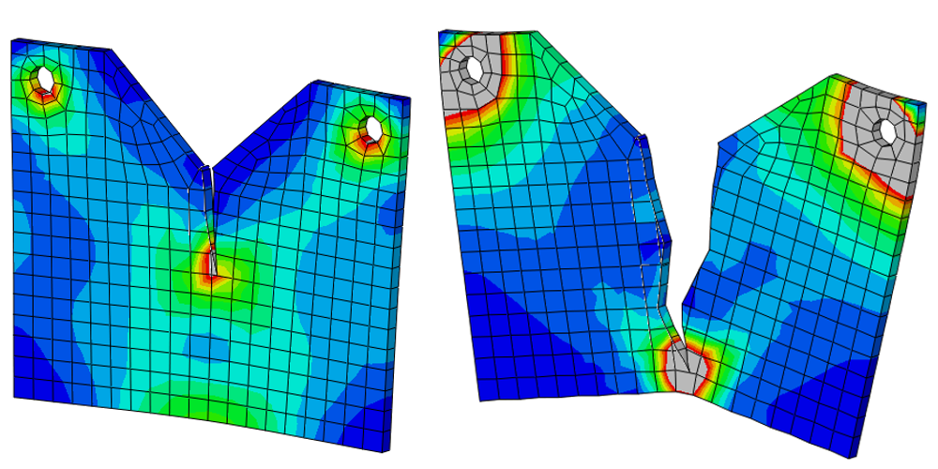
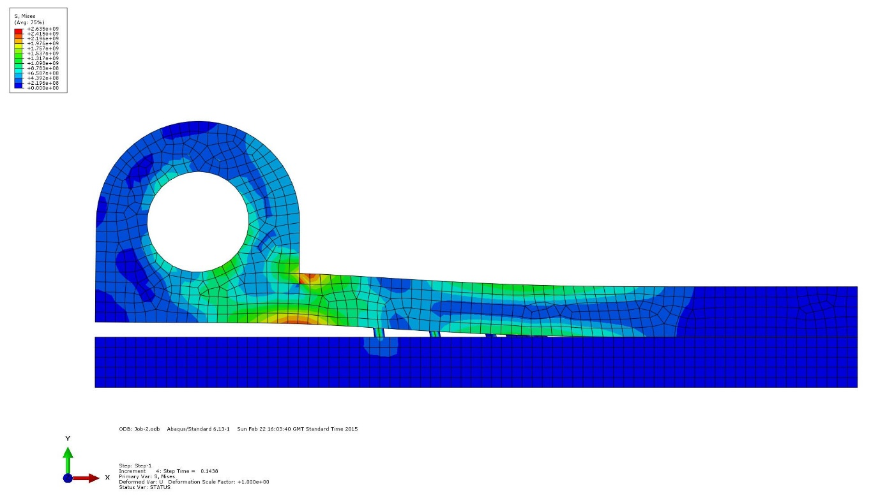
Recap
Slime Mold Network
Abaqus
XFEM
hydraulic copula CZM
python

Slide 3
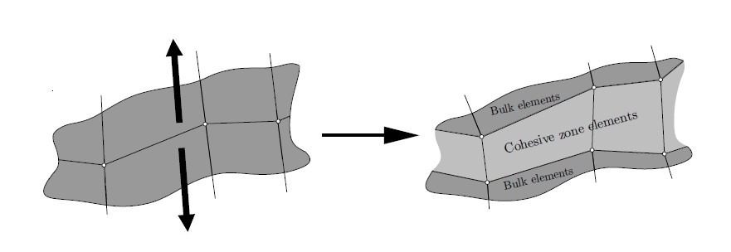

Slide 4
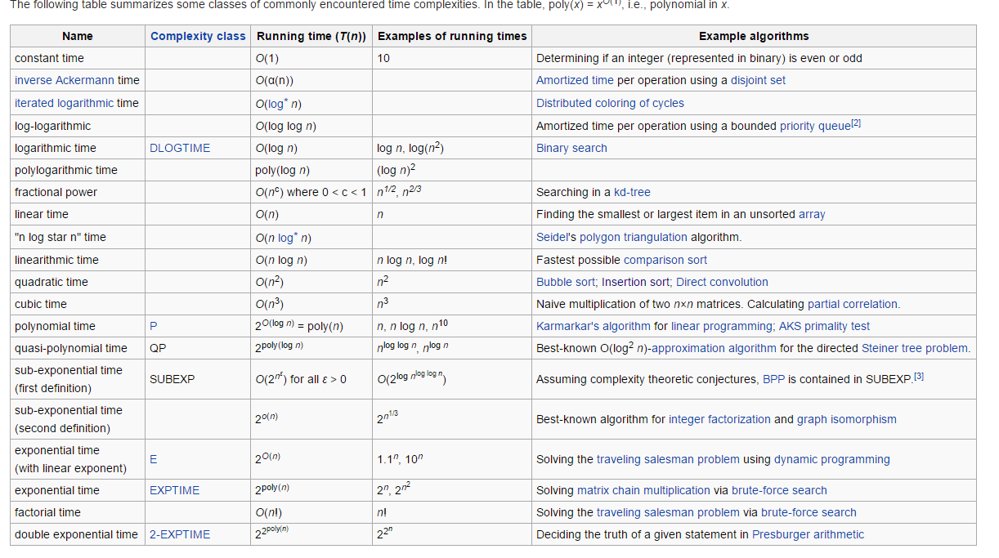
Function: f(x) = X^5 + x^2 + c
Dominated factor: X^5
Execution time of Python script
Loop: might increase degree

Slide 5
Python Script – overall structure
Read from input file runtime = T(n) + ???
Manipulation, updating, modification depends
Write an output file runtime = T(n) + ???

Slide 6
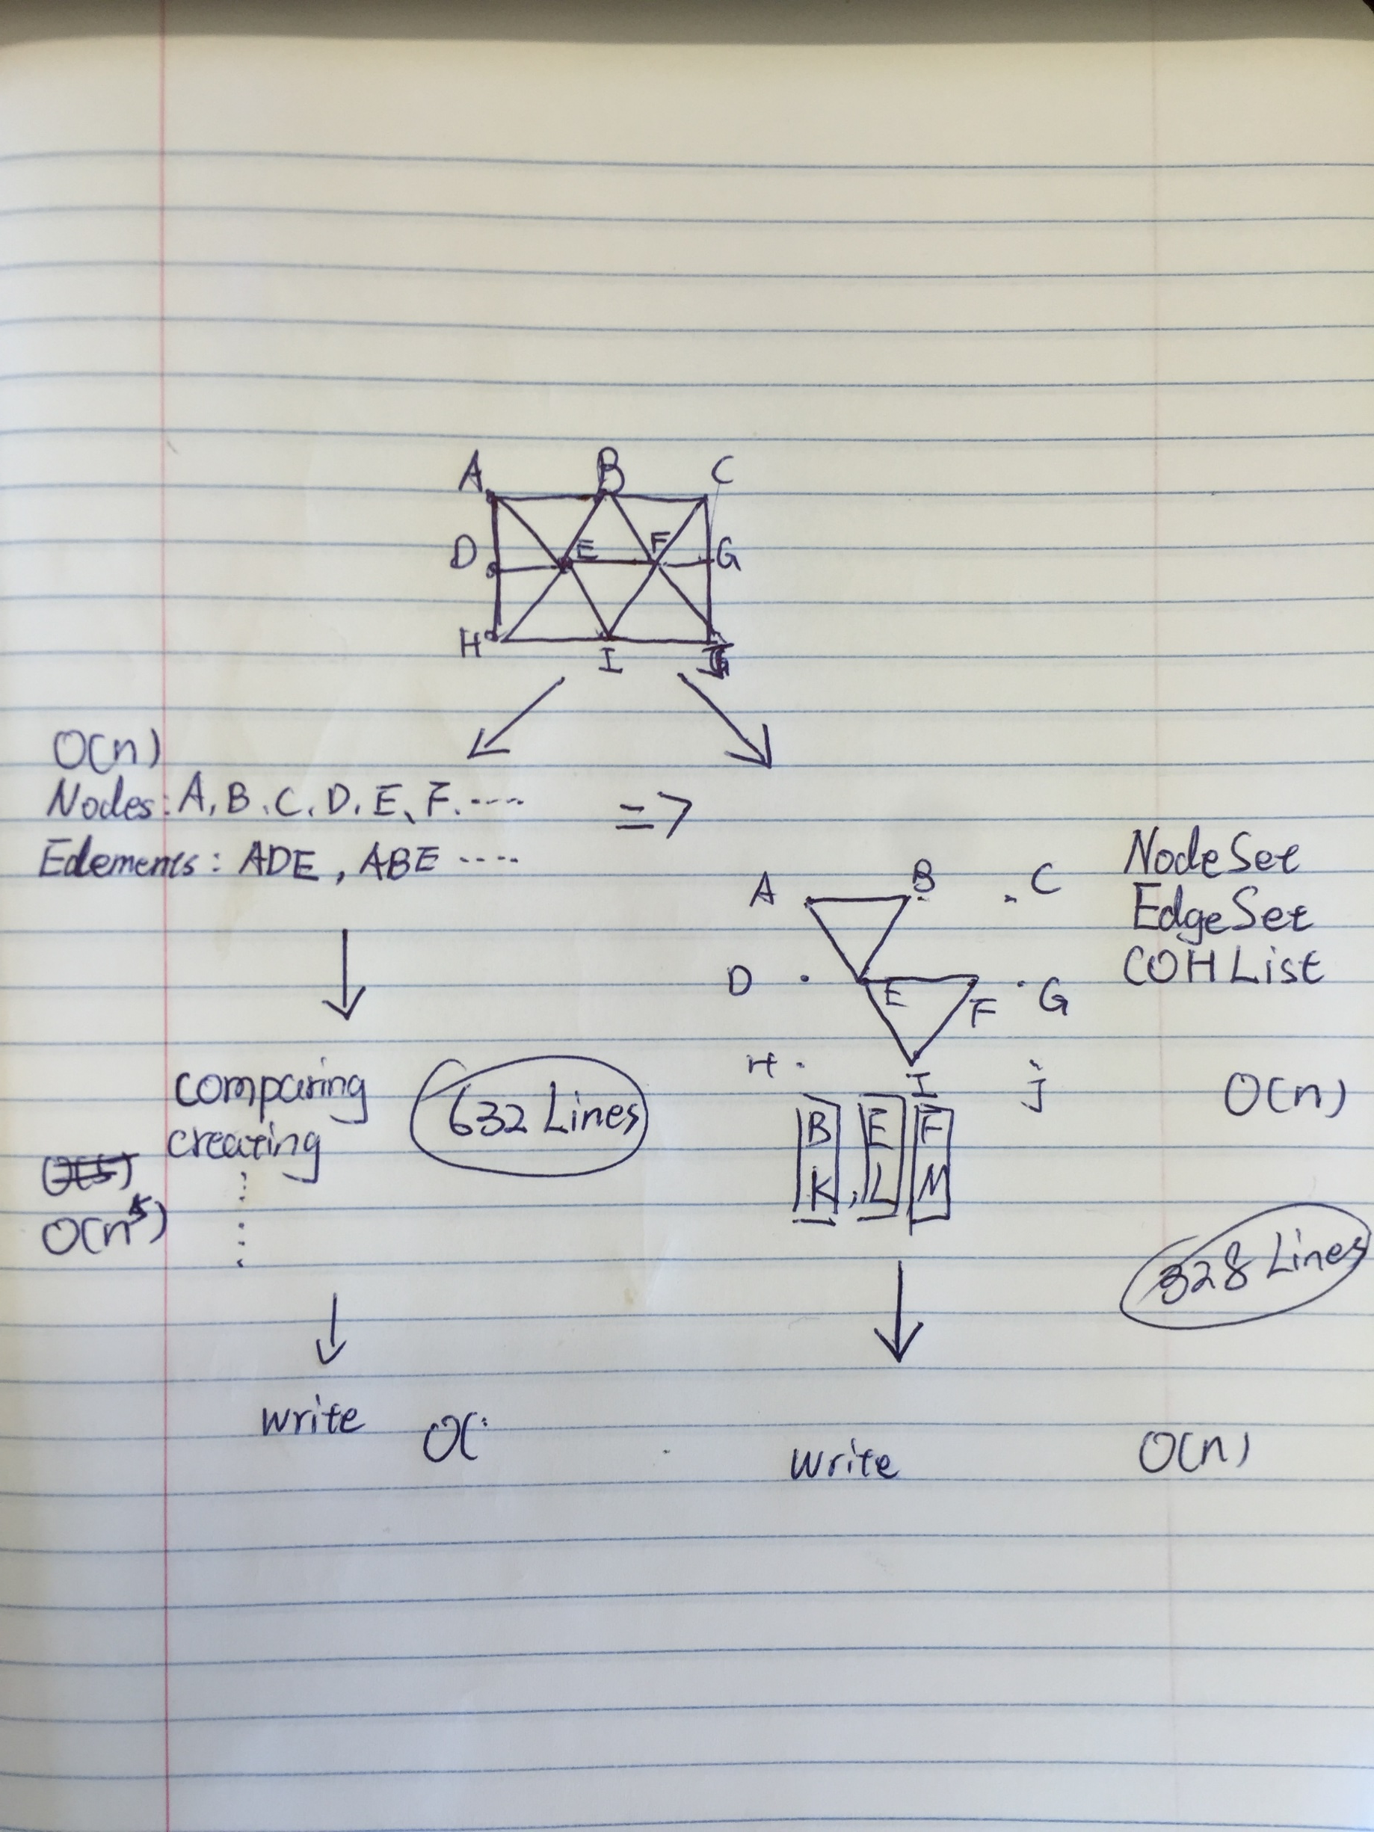

Slide 7
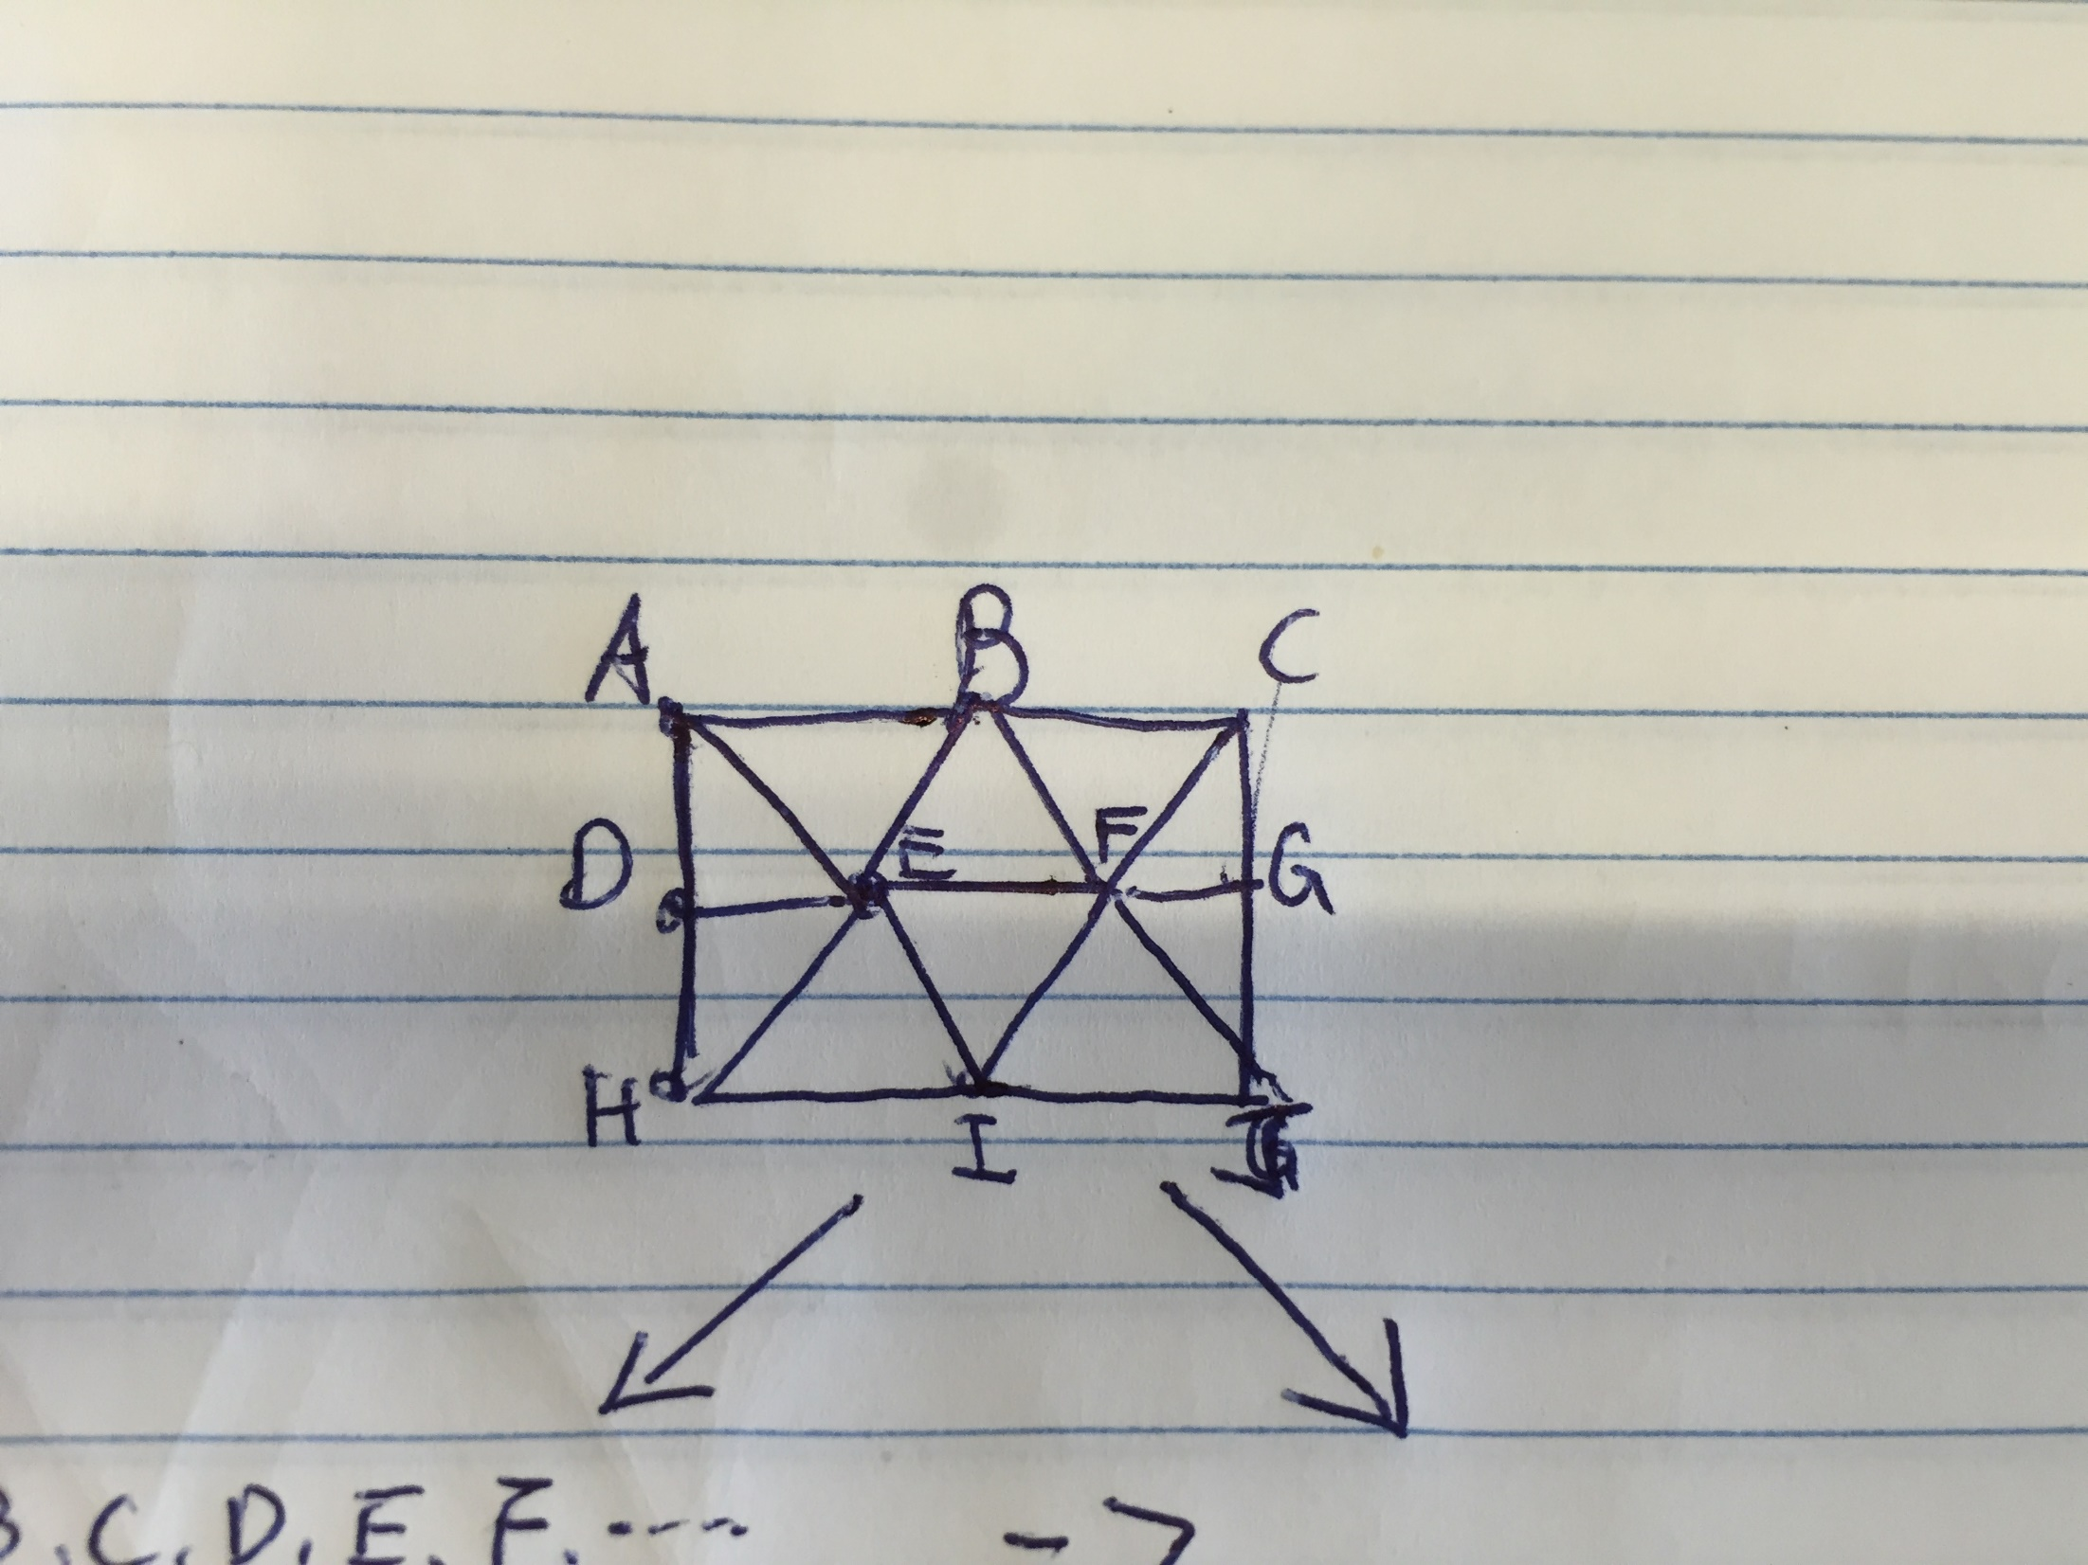

Slide 8
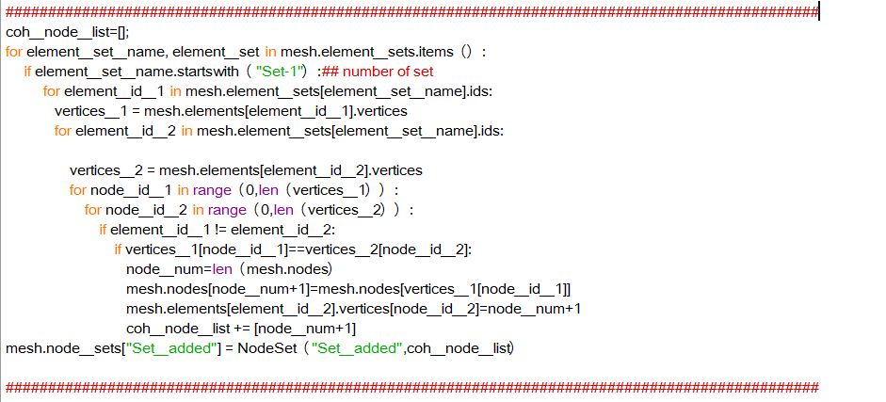

Slide 9
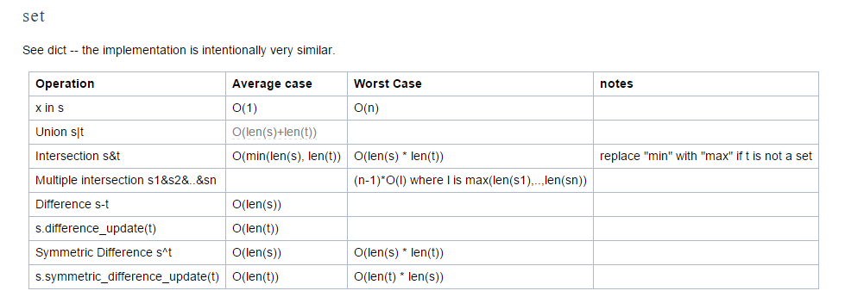
“in” operator O(1)
Sets Addition O(1)
Create Nodes O(1)
Update O(1)
CohElementList append O(1)
Loop through data O(n)
Overall O(n)
From O(n^5) → O(n) Memory Usage O(n) * 3

Slide 10
2D Homogeneous Model
Model A(Test)
1 part
443 Nodes
800 Elements (meshes)
Model B(Test2)
1 part
6565 Nodes
12800 Elements (meshes)

Slide 11
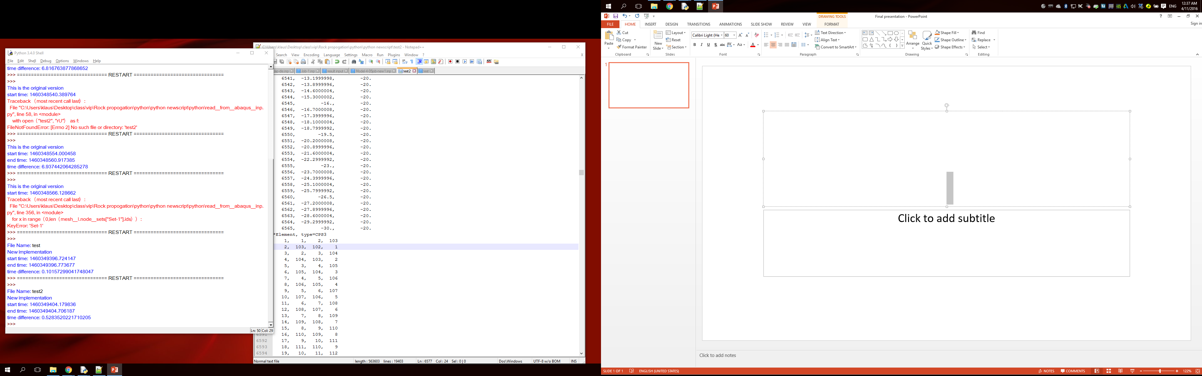
1460349396.724147 - 1460348566.128662 = 830.595484972 seconds

Slide 12
Small size efficiency: 683%
Large size efficiency: At least 157205%

Slide 13
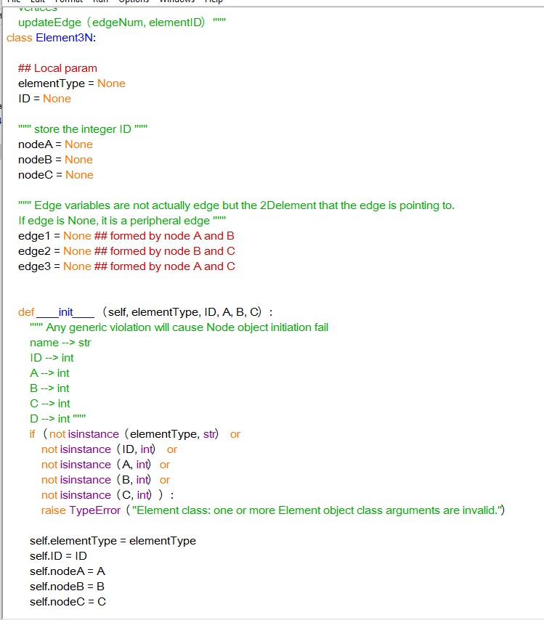
Next Semester
Edge cases
Add contact property
Back to abaqus

